Slide 1

1st REVIEW
Intelligent Recruitment Platform with Database Systems and Backend Engineering
VUNNAM VEDAPRIYA SRISAIKALA | 2520030376
NALLA TEJASRI | 2520030132
SHETTENI TEJA | 2520030419
BURLLA CHENNA MALLESWAR REDDY | 2520030546
Under the Guidance
of
Dr.Y Subbarayudu
Assitant Professor
Department of Computer Science and Engineering
KONERU LAKSHMAIAH EDUCATION FOUNDATION

Slide 2
GROUP NUMBER:1
Name of Candidate | Role
VUNNAM VEDAPRIYA SRISAIKALA | 2520030376
NALLA TEJASRI | 2520030132
SHETTENI TEJA | 2520030419
BURLLA CHENNA MALLESWAR REDDY | 2520030546

Slide 3
ABSTRACT
The Intelligent Recruitment Platform is a database-driven software system designed to simplify and improve the recruitment process for organizations and job seekers. Traditional recruitment processes often involve manual resume screening, maintaining candidate information in separate files, communicating with applicants through different platforms, and tracking job applications manually. These activities can consume significant time and may result in data duplication, delays, and difficulty in managing large amounts of recruitment information.
The proposed platform provides a centralized system for managing job postings, candidate profiles, resumes, applications, recruiters, interviews, and recruitment status. The system uses a structured database to store and organize recruitment-related information efficiently. A backend application handles business logic, authentication, data processing, job management, application processing, and communication between the user interface and database.
The platform aims to provide a faster, more organized, and reliable recruitment workflow. It can help recruiters identify suitable candidates efficiently while allowing applicants to search for jobs, maintain their profiles, submit applications, and track their application status. The system also provides better data consistency, security, and scalability through proper database design and backend engineering.

Slide 4
INTRDOUCTION
Recruitment is an important process for every organization because selecting the right candidate directly affects productivity and business performance. In conventional recruitment systems, recruiters may need to handle large numbers of resumes, job applications, candidate details, interview schedules, and selection records manually or through multiple disconnected systems. Managing this information becomes difficult when the number of applicants and job openings increases.
The Intelligent Recruitment Platform is proposed to provide a centralized and systematic solution for recruitment management. The platform connects candidates and recruiters through a single application where job-related information can be created, stored, searched, updated, and managed efficiently.
The system uses database systems and backend engineering as its core components. The database maintains candidate, recruiter, job, application, and interview information in an organized manner. The backend manages authentication, validation, application processing, business rules, and database communication.
By automating important recruitment activities, the proposed system can reduce manual effort, improve information accuracy, provide faster access to candidate data, and make the overall recruitment process more efficient.

Slide 5
EXISTING SYSTEM
In many traditional recruitment systems, job vacancies and candidate information are managed using separate files, spreadsheets, emails, or independent recruitment platforms. Recruiters often have to manually collect resumes, review candidate information, shortlist applicants, schedule interviews, and update selection status.
Such systems can create several difficulties when a large number of candidates apply for multiple job positions. Searching for a particular candidate or application may take considerable time. Duplicate records may also be created when information is entered repeatedly. Maintaining application status manually can result in outdated or inconsistent information.
Another limitation is the lack of proper integration between different recruitment activities. Job posting, candidate management, application tracking, interview scheduling, and selection records may not be connected through a single centralized database.
Therefore, the existing approach can become time-consuming, difficult to maintain, less organized, and inefficient for large-scale recruitment operations.

Slide 6
PROBLEM
The recruitment process involves managing a large amount of information related to candidates, job openings, resumes, applications, recruiters, interviews, and selection decisions. When this information is handled manually or through disconnected systems, several problems can occur.
Major problems include:
Large amounts of candidate information are difficult to manage manually.
Recruiters spend significant time reviewing and organizing applications.
Candidate information may be duplicated or stored inconsistently.
Tracking application status can become difficult.
Searching for suitable candidates may take considerable time.
Communication between recruiters and candidates may not be centralized.
Interview schedules can be difficult to manage.
Manual data entry can lead to errors.
Generating recruitment-related reports becomes difficult.
Maintaining secure and consistent recruitment records is challenging.

Slide 7
SOLUTION(Contribution)
The proposed Intelligent Recruitment Platform provides an integrated solution for managing the complete recruitment workflow. The system maintains recruitment data in a centralized database and uses backend services to process requests and enforce application-level business rules.
Candidates can create their profiles, upload or maintain resume information, search for available job opportunities, and apply for suitable positions. Recruiters can create job postings, view applications, examine candidate profiles, shortlist candidates, and update recruitment status.
The backend acts as the main communication layer between the user interface and database. It validates user inputs, performs authentication, processes job and application requests, and manages database operations. Proper database relationships are used to connect candidates, jobs, applications, recruiters, and interviews.
The major contribution of the proposed system is the integration of database management, backend engineering, recruitment workflow automation, and centralized information management into one platform. This can improve efficiency, reduce repetitive manual work, and provide a more organized recruitment experience.

Slide 8
Objectives
The main objective of the project is to develop an intelligent and centralized recruitment platform that simplifies the interaction between candidates and recruiters while efficiently managing recruitment data.
Specific objectives are:
To develop a centralized platform for managing recruitment activities.
To maintain candidate information using a structured database.
To provide recruiters with an efficient job posting and application management system.
To allow candidates to search and apply for suitable job opportunities.
To provide secure user authentication and role-based access.
To maintain application status and recruitment history systematically.
To reduce manual data entry and repetitive recruitment activities.
To provide efficient searching and retrieval of candidate and job information.
To design a reliable backend for handling recruitment-related operations.
To improve data consistency, security, scalability, and overall system performance.

Slide 9
Modules
1. User Authentication Module
This module manages registration and login for candidates and recruiters. It provides authentication and ensures that users can access features according to their roles.
2. Candidate Management Module
Candidates can create and update their profiles by providing personal details, educational qualifications, technical skills, experience, and resume information.
3. Recruiter Management Module
Recruiters can manage their organization information, create job opportunities, view applications, and manage candidates during the recruitment process.
4. Job Management Module
This module allows recruiters to create, update, and manage job postings. Candidates can search available jobs based on different requirements.

Slide 10
5. Application Management Module
Candidates can apply for jobs, while recruiters can view applications and update the application status such as applied, shortlisted, interview scheduled, selected, or rejected.
6. Interview Management Module
This module helps recruiters manage interview schedules, candidate details, interview dates, and interview status.
7. Database Management Module
This module stores and manages information related to users, candidates, recruiters, jobs, applications, interviews, and other recruitment records using a structured relational database.
8. Search and Filtering Module
The system can provide searching and filtering options to help recruiters find candidates and candidates identify relevant job opportunities more efficiently.

Slide 11
SOFTWARE REQUIREMENTS
Category | Requirement
Operating System | Windows 10/11, Linux Ubuntu
Programming Language | Java / JavaScript
Frontend | HTML5, CSS3, JavaScript
Backend | Java Spring Boot / Node.js
Database | MySQL
Database Management | MySQL Workbench
Development Environment | Visual Studio Code / IntelliJ IDEA
API Testing | Postman
Version Control | Git and GitHub
Browser | Google Chrome / Microsoft Edge
Database Connectivity | JDBC / REST API
Documentation | Microsoft PowerPoint / MS Word

Slide 12
CONCLUSION AND FUTURE SCOPE
Conclusion
The Intelligent Recruitment Platform with Database Systems and Backend Engineering provides a centralized solution for managing the recruitment process. It brings candidates, recruiters, job postings, applications, and interviews together on a single platform, reducing manual work and making recruitment activities easier to manage.
The structured database securely stores candidate, recruiter, job, application, and interview information. The backend handles authentication, validation, business logic, and database communication, helping to improve data consistency and reduce duplication.
Overall, the system makes the recruitment process faster, organized, reliable, and easier to maintain for both recruiters and candidates.
Future Scope
In the future, Artificial Intelligence and Machine Learning can be added for automatic resume screening and candidate-job matching. The system can also include resume parsing to extract skills, education, and experience automatically.
Additional features such as automated notifications, recruitment chatbots, interview scheduling, analytics dashboards, cloud deployment, and advanced security can be integrated. These improvements can make the platform more intelligent, scalable, and suitable for real-world recruitment organizations.

Slide 13
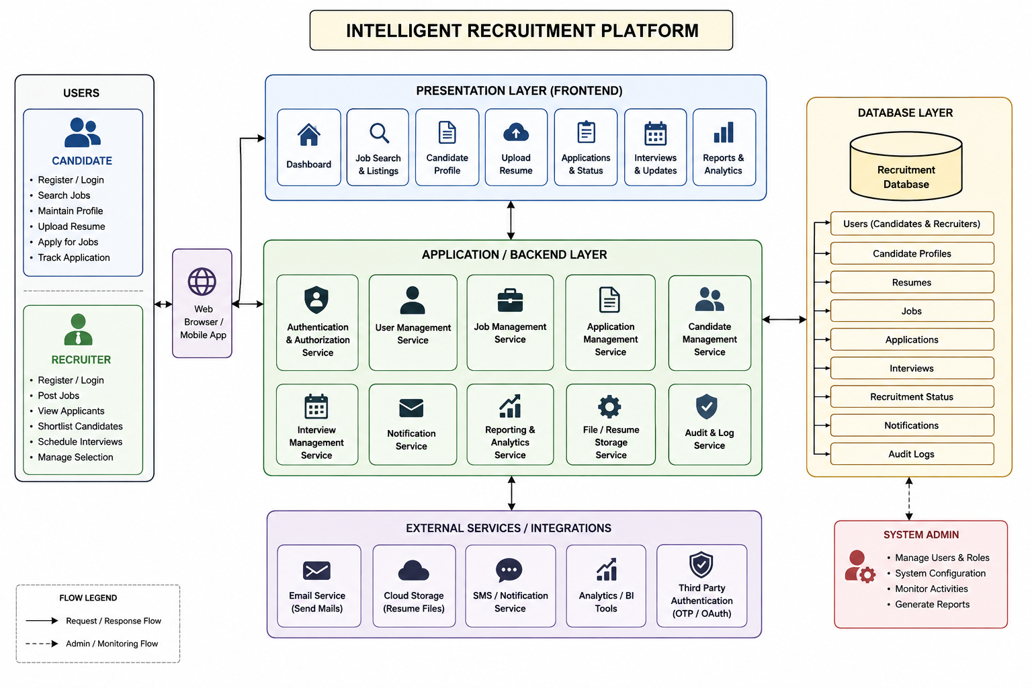
SYSTEM ARCHITECTURE

Slide 14
THANK YOU

